Slide 1
LINUX DEVICE DRIVER
DAY 25 PPT
-SUBITHRA S

Slide 2
Kernel Module:
A kernel module is a loadable piece of code that can be added to or removed from the running kernel without rebooting the system.
Modules extend the functionality of the kernel, providing support for new hardware, file systems, or system services.
They can be developed independently and plugged into the kernel as needed.
Character Device:
In Linux, devices can be broadly categorized into character devices, block devices, and network devices.
A character device allows data to be read or written sequentially, byte by byte, without buffering.
Examples of character devices include keyboards, mice, serial ports, and devices accessed through /dev/.
Kernel Space vs. User Space:
The kernel space is the privileged area of memory where the core functions of the operating system execute.
User space is where user applications and programs run, isolated from direct access to hardware and kernel data structures.
Kernel modules bridge the gap between kernel space and user space, providing controlled access to system resources.

Slide 3
Device Registration:
When a kernel module is loaded, it typically registers a device with the kernel. This involves obtaining a major number, which identifies the device type, and optionally, a minor number for specific instances of the device.
The device registration process involves defining the device's file operations (such as open, close, read, and write) through a struct file_operations.
File Operations:
File operations define how the device interacts with user-space programs. For instance, open and release handle device open and close operations, while read and write manage data transfer.
Accessing the Device:
Once registered, the device appears as a file in the /dev/ directory (e.g., /dev/my_device). User-space programs can access the device using standard file operations like open(), read(), write(), and close().
Data Transfer:
Data transfer between user space and the device occurs through system calls like read() and write(). Kernel functions like copy_to_user() and copy_from_user() ensure safe data transfer between kernel and user space.

Slide 4
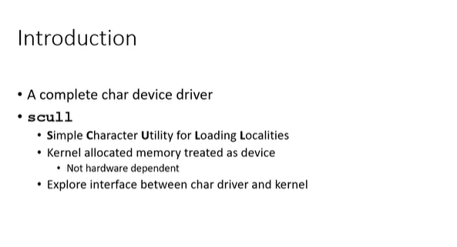

Slide 5
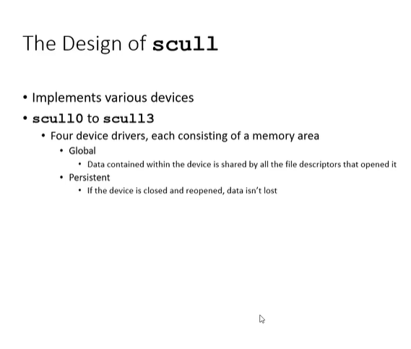

Slide 6
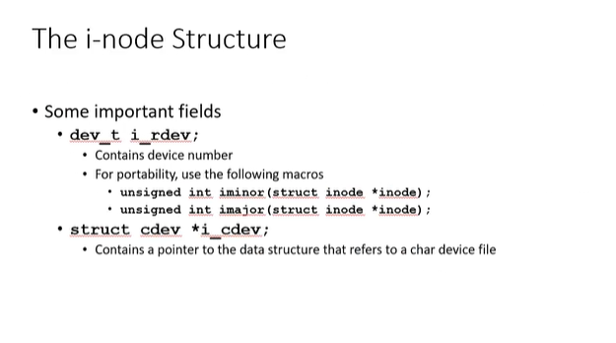

Slide 7
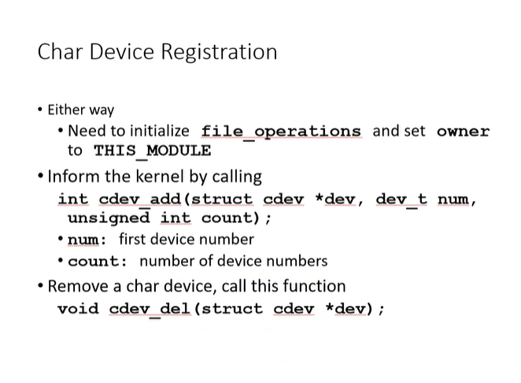

Slide 8
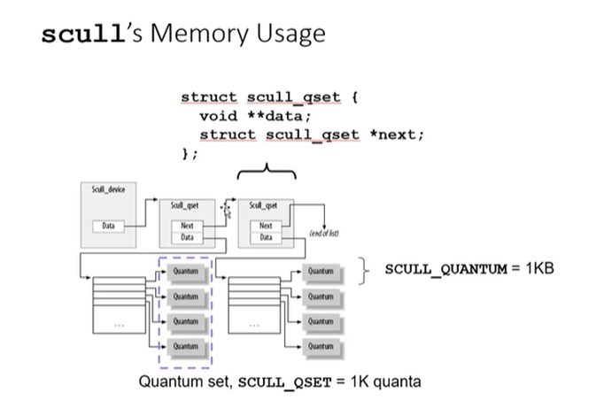

Slide 9
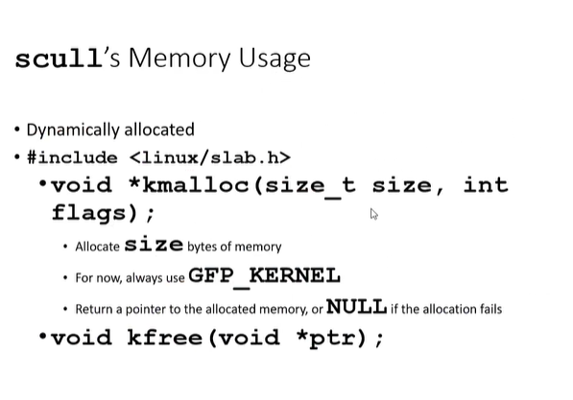

Slide 10
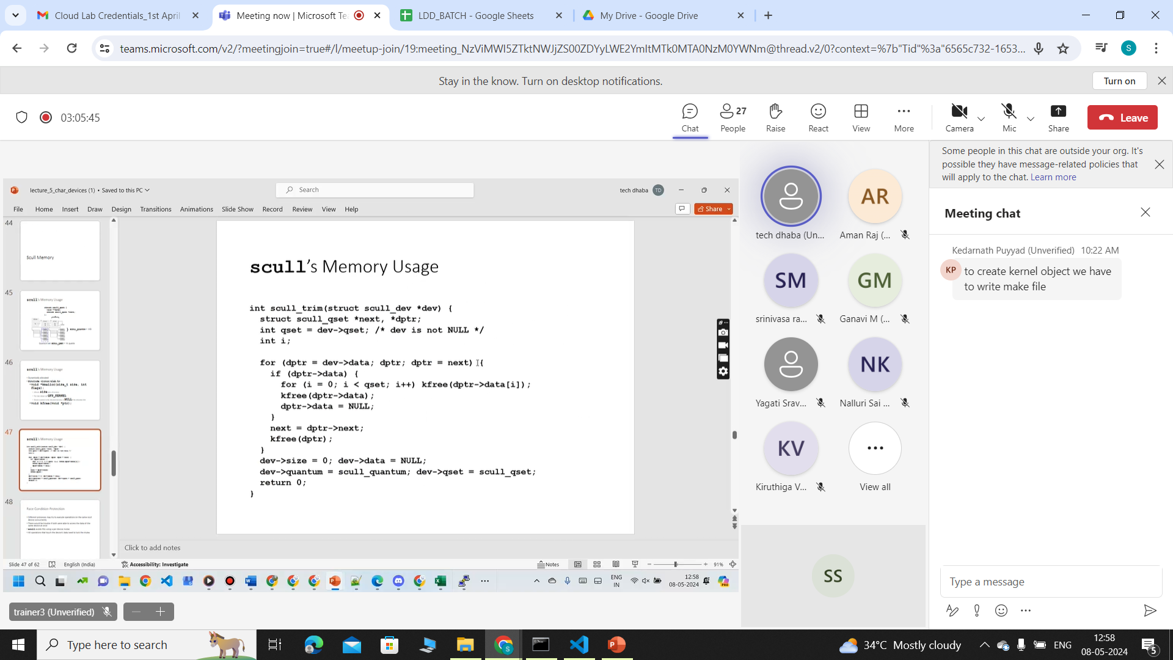

Slide 11
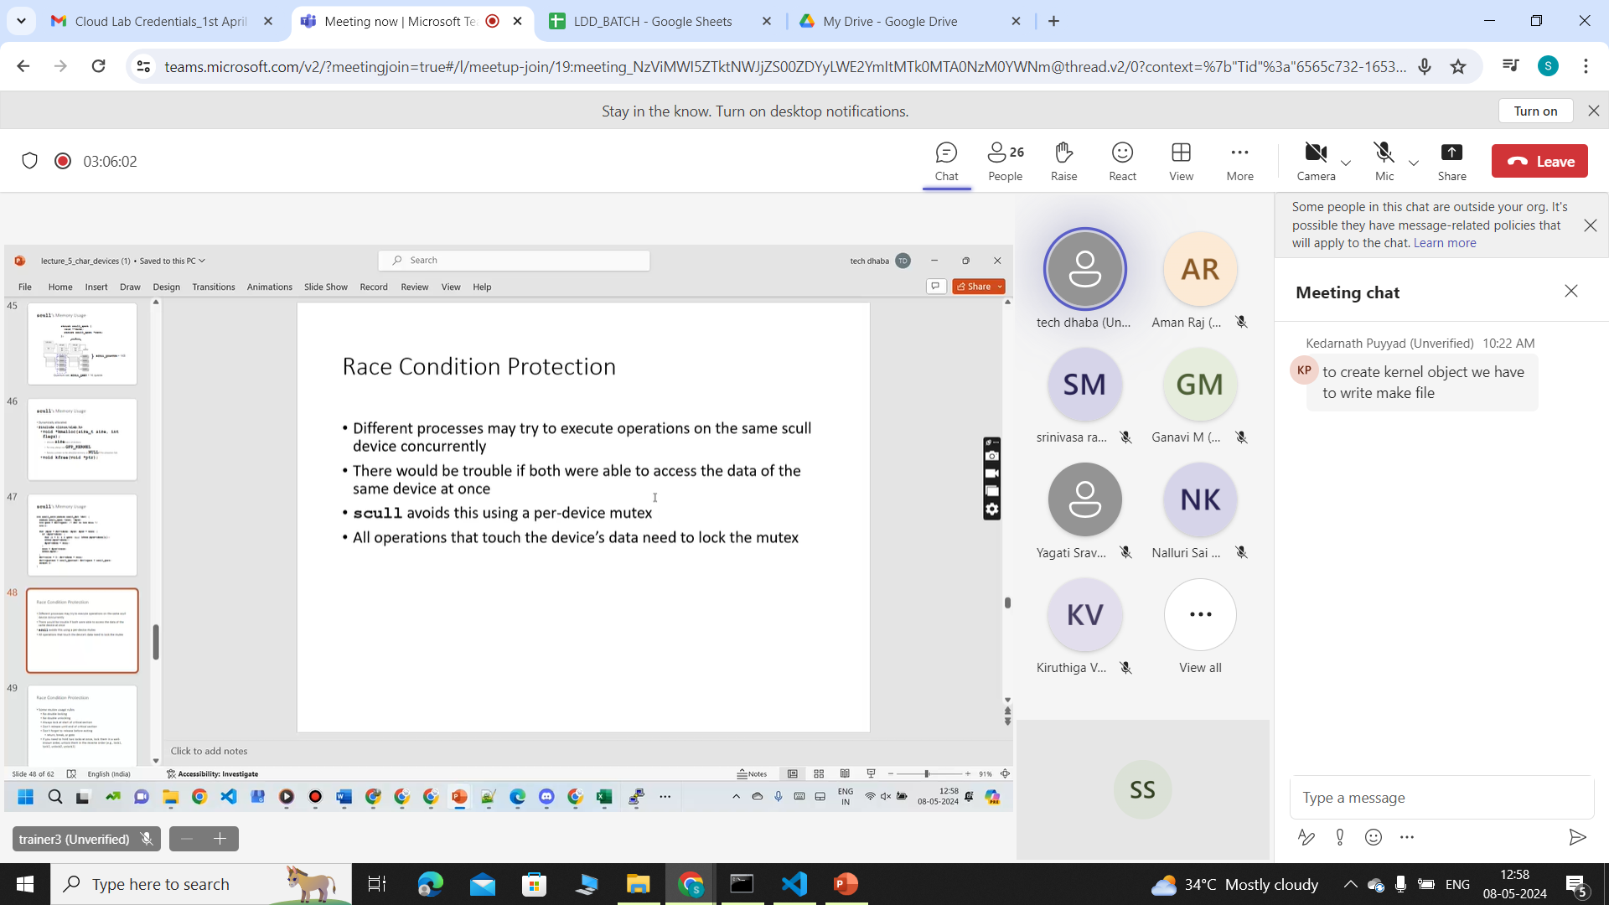

Slide 12
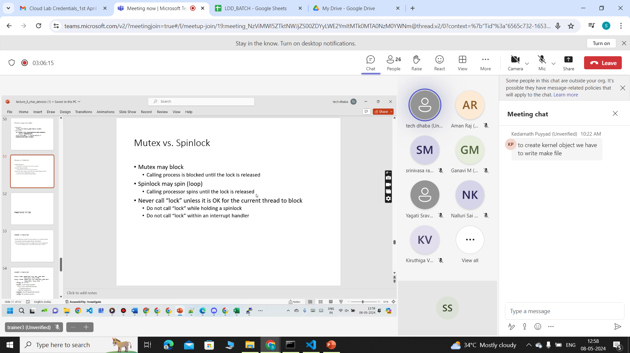

Slide 13
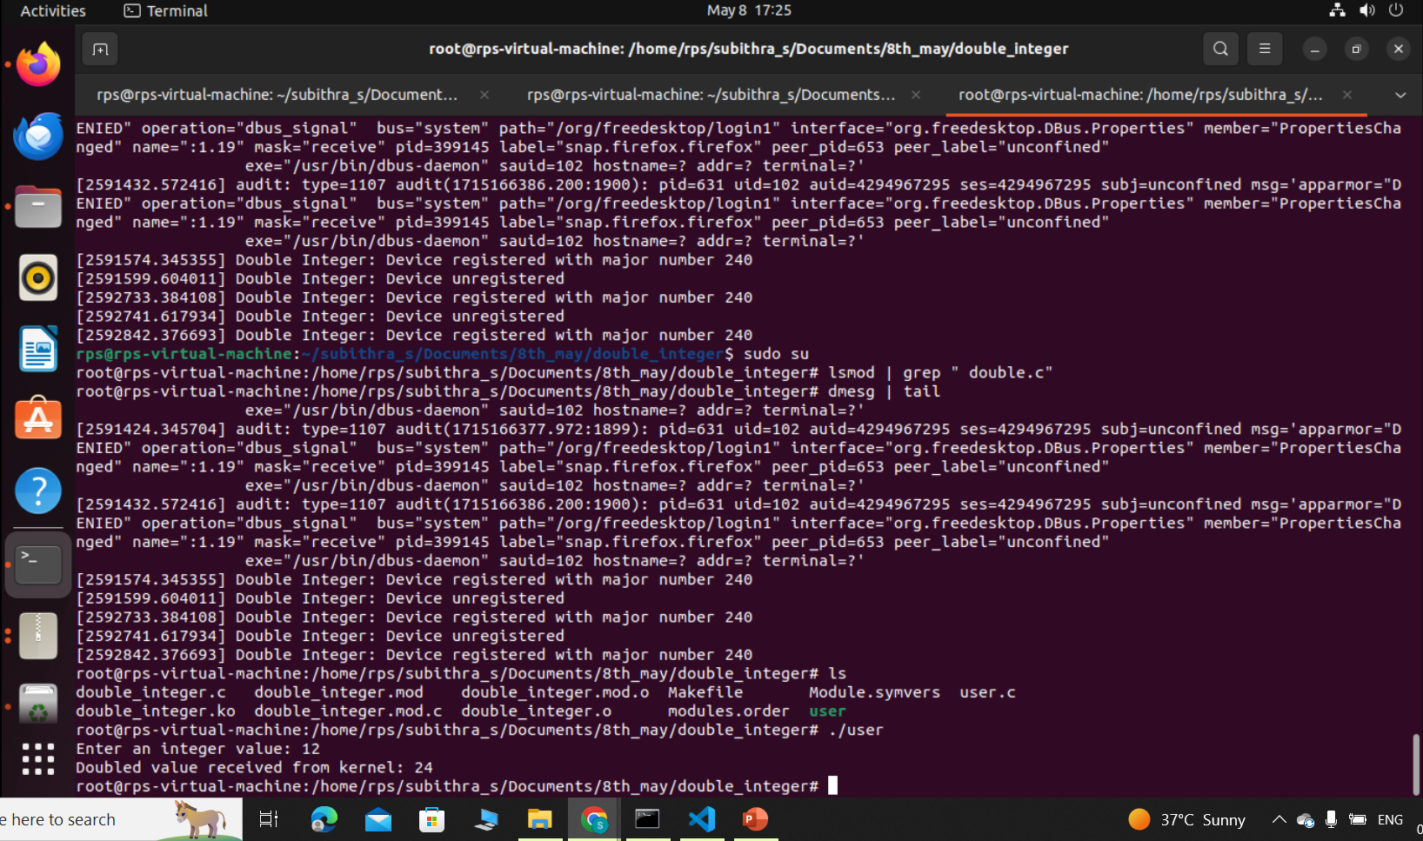
make
sudo insmod double_integer.ko
dmesg |tail
sudo mknod /dev/double_integer c 240 0
sudo su
make user
./user

Slide 14
THANK YOU

